Slide 1
AI Personal Financial Analyzer
Smart Financial Insights from Your PDF Statements
By Ramya Murugesan
🔗 GitHub | 🔗 Hugging Face Space

Slide 2
Problem Statement
Develop an AI-powered application that processes UPI transaction statements from multiple apps (Paytm, GPay, PhonePe, etc.) and generates actionable insights and personalized financial advice using LLMs
The system must extract transaction details from varied PDF formats, and deliver tailored recommendations to users via an interactive dashboard or report.

Slide 3
Proposed Solution
Upload your UPI PDF statement
The app extracts & parses transaction data using PyMuPDF
It categorizes your expenses
A built-in LLM (via Gemini API) analyzes the data and generates:
Monthly budget insights
Wasteful spending alerts
Smart financial suggestions

Slide 4
Tech Stack
Layer | Tools Used
Frontend | Streamlit (Hugging Face)
PDF Parsing | PyPDF2, PyMuPDF
AI Engine | Gemini LLM (Google AI)
Deployment | Hugging Face Spaces

Slide 5
Workflow
User Uploads PDF
PDF Text Extracted
Analyzed & Categorized
Gemini Generates Smart Advice

Slide 6
Features & Output
💸 Total Income, Expenses, and Savings %
📂 Category-wise Spending Chart
🔍 Gemini-generated Advice like:
“You spent ₹1,500 on food delivery this month — consider reducing to save more.”

Slide 7
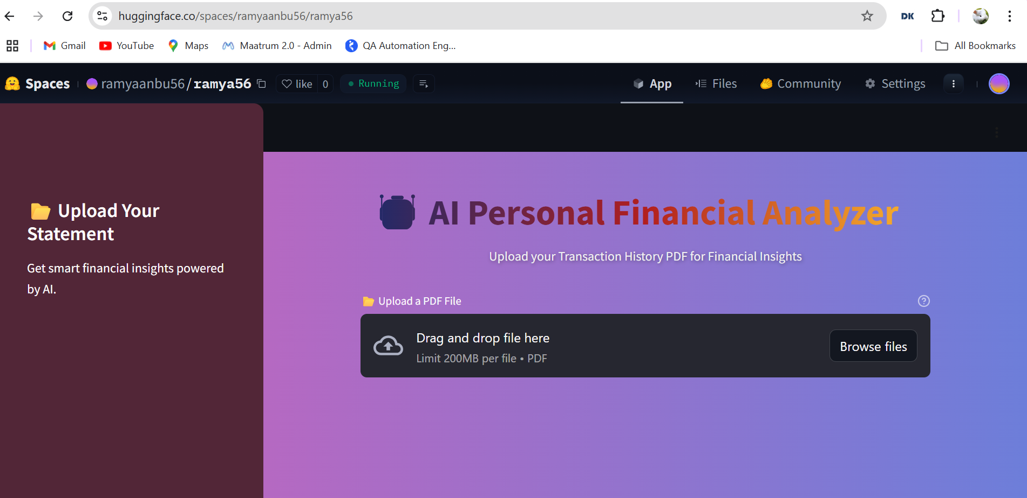
Live App
Try it here:
🔗 https://huggingface.co/spaces/ramyaanbu56/ramya56

Slide 8
Challenges & Learnings
Handling scanned/incomplete PDFs
Ensuring accurate transaction parsing
Writing consistent Gemini prompts
Making the UI user-friendly and engaging

Slide 9
Thank You / Q&A
Thanks for your time!
Connect: ramya.anbu@example.com
🔗 GitHub | 🔗 Hugging Face Space

